Slide 1

SWP391: FINAL PROJECT PRESENTATION
Sherah Warehouse System

Slide 2
Project Overview
Project team members:
Phạm Đức Đạt- HS176052
Nguyễn Trung Đức- HE181557
Nguyễn Đức Cường- HE180767
Hoàng Nghĩa Hưng- HE187092
Nguyễn Văn Trường - HE170937

Slide 3
Project Overview
Product introduction & scope:
Sherah is a newly established youth clothing store. With the growing speed of the store, the store needs a system to manage the import process and inventory quantity in the warehouse. The warehouse management system (wms) was created with the purpose of supporting managers to monitor products, suppliers, bins... and also to view warehouse statistics reports. The manager who supervises the warehouse inventory process, confirms and clears differences when there is a change in quantity during the inspection process. The purchasing staff will be the person who creates the purchase order according to the supplier. The storage staff will receive the information of the purchase order and is also the person who performs the stock checking process in the warehouse. The admin is the person who manages accounts.

Slide 4




Project Overview
Manage Project:

Slide 5
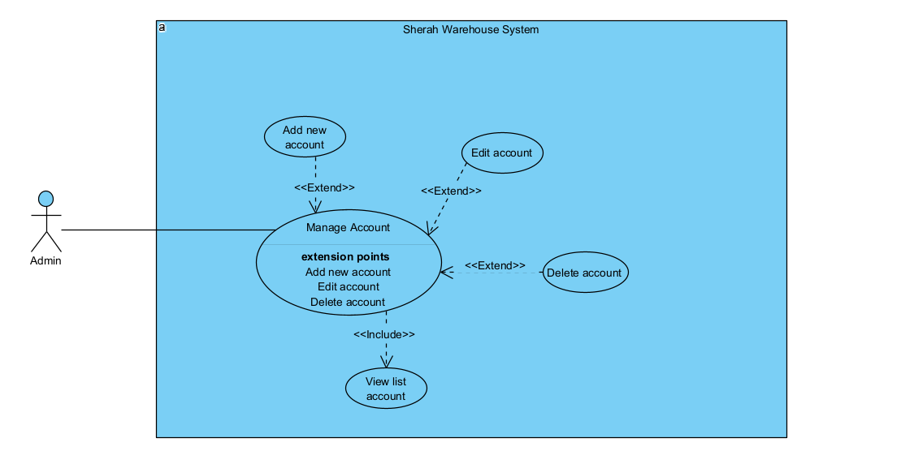
Product Requirements Use Case Diagrams
Use Case for Admin

Slide 6
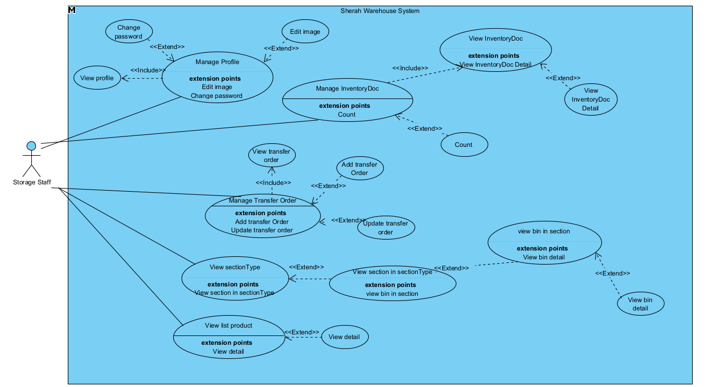
Product Requirements Use Case Diagrams
Use Case for Storage Staff

Slide 7
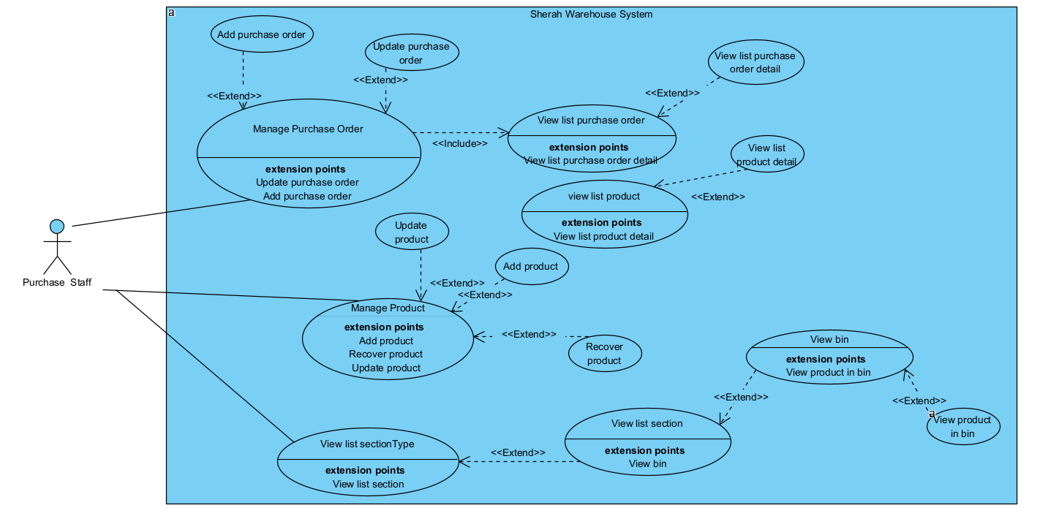
Product Requirements Use Case Diagrams
Use Case for Purchase Staff

Slide 8
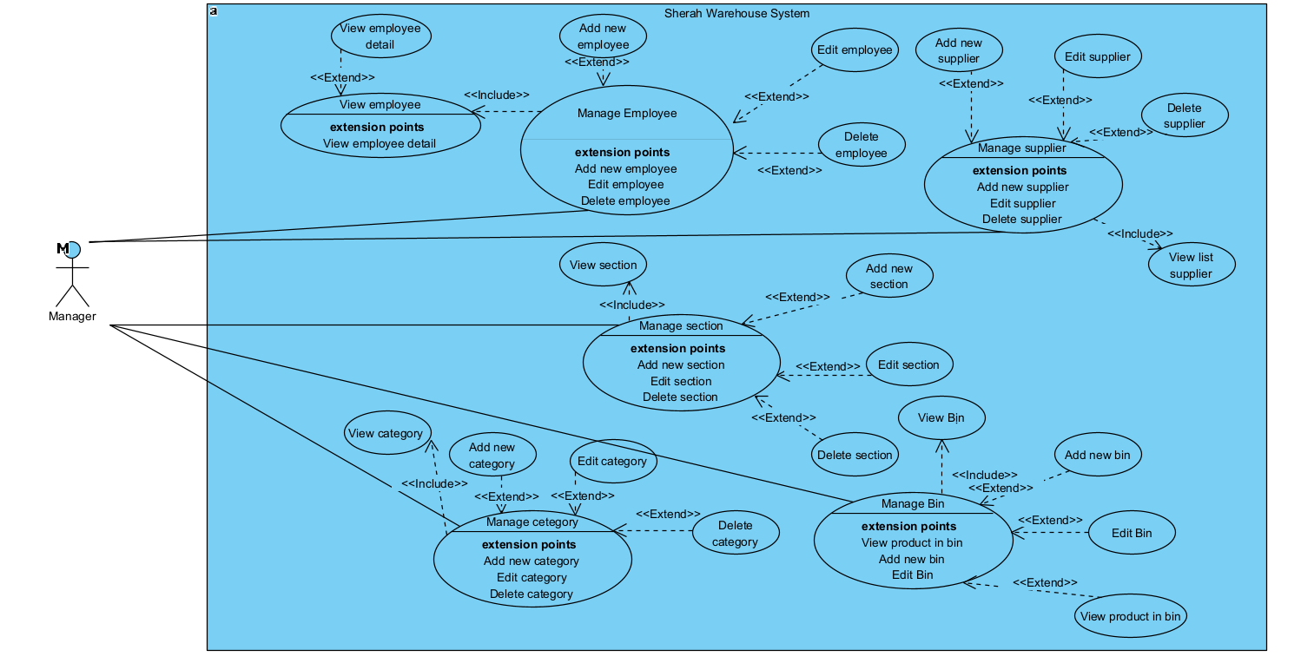
Product Requirements Use Case Diagrams
Use Case for Manager

Slide 9
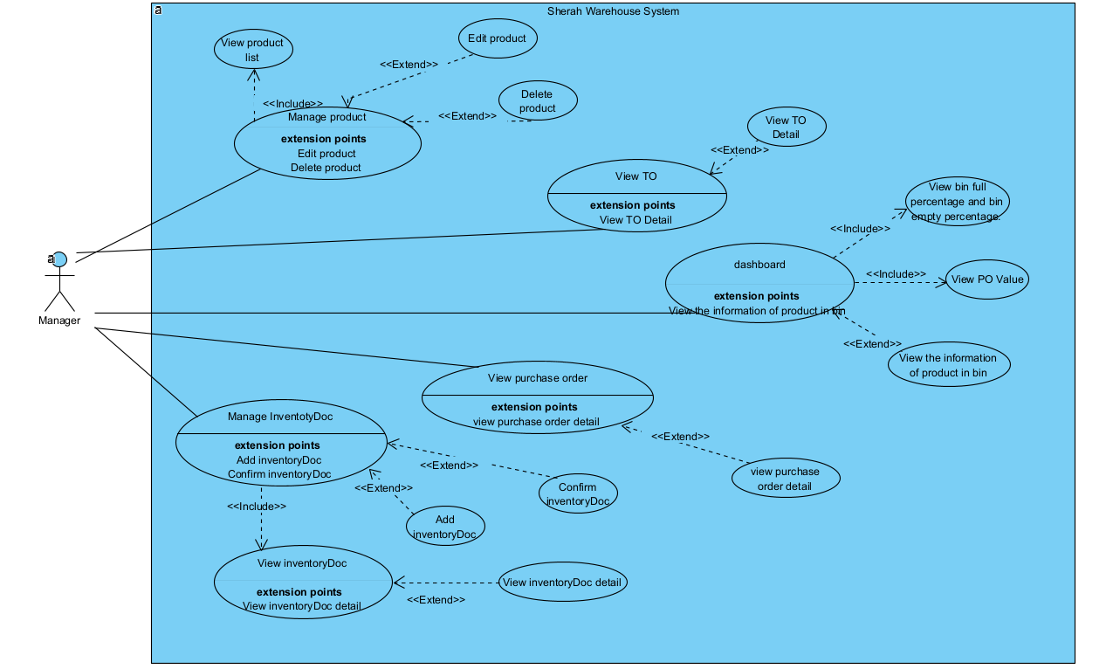
Product Requirements Use Case Diagrams
Use Case for Manager

Slide 10
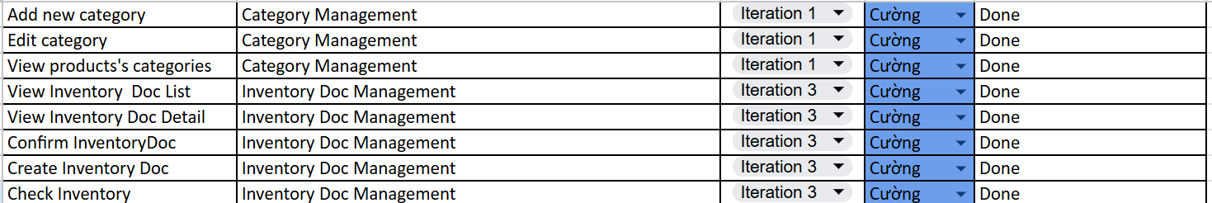
Product Requirements Use Case Diagrams
Worklist for each member.

Slide 11
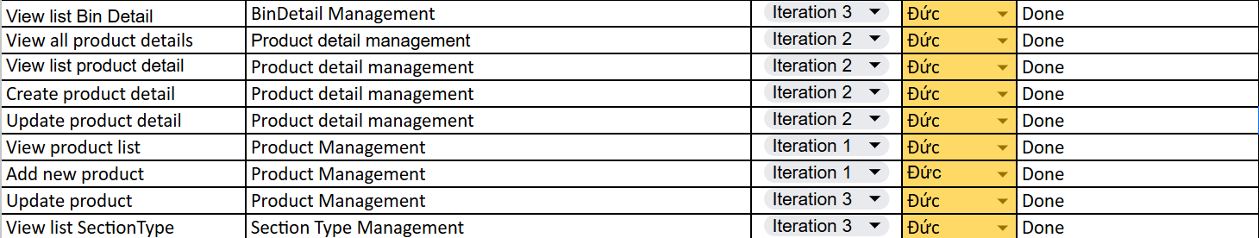
Product Requirements Use Case Diagrams
Worklist for each member.

Slide 12
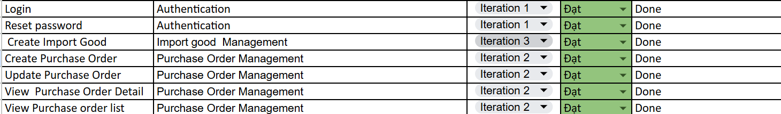
Product Requirements Use Case Diagrams
Worklist for each member.

Slide 13
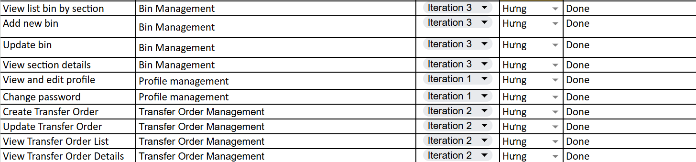
Product Requirements Use Case Diagrams
Worklist for each member.

Slide 14
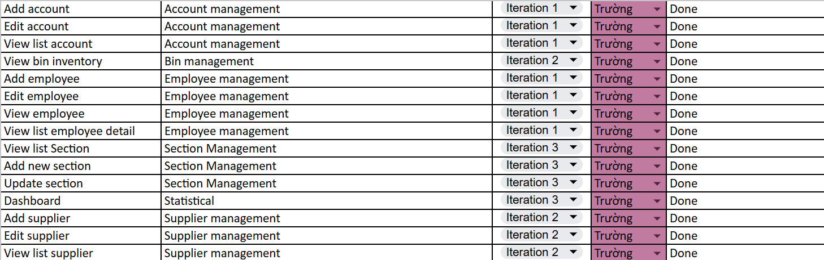
Product Requirements Use Case Diagrams
Worklist for each member.

Slide 15
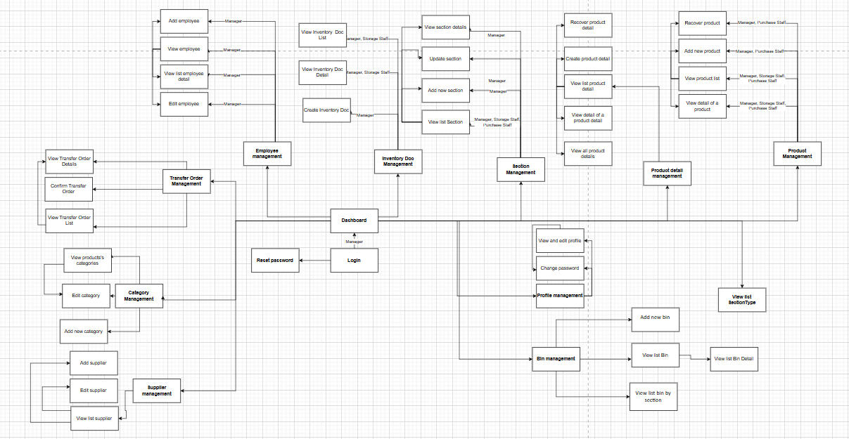
Product Requirements Product Functionalities
ScreenFlow of Manager

Slide 16
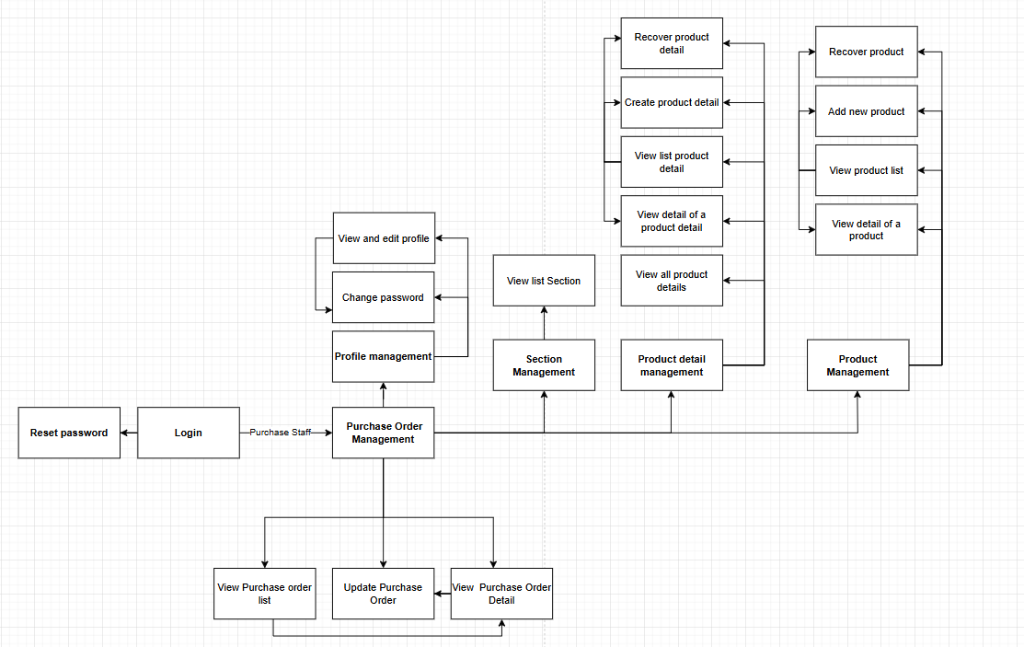
Product Requirements Product Functionalities
ScreenFlow of Purchase Order Staff

Slide 17
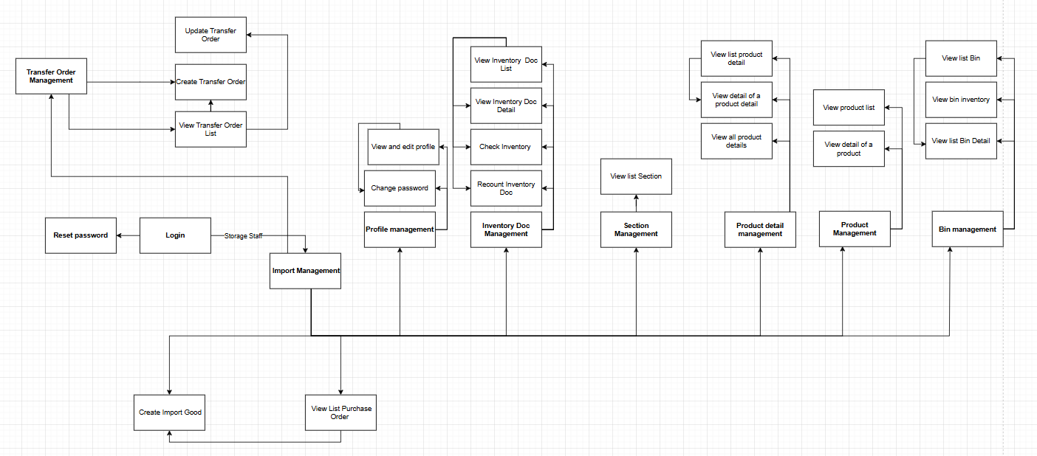
Product Requirements Product Functionalities
ScreenFlow of Storage Staff

Slide 18
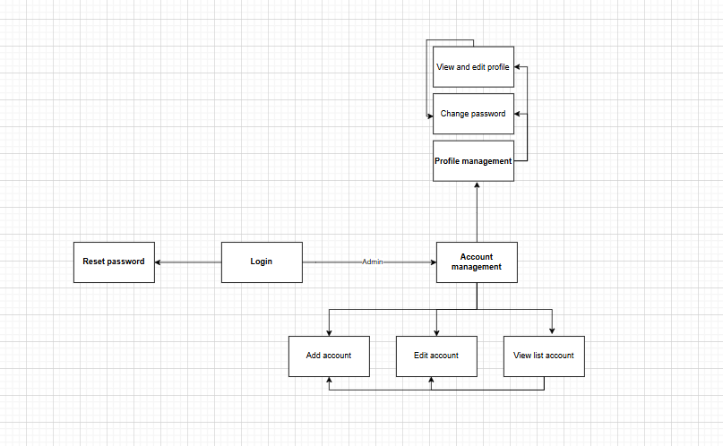
Product Requirements Product Functionalities
ScreenFlow of Admin

Slide 19
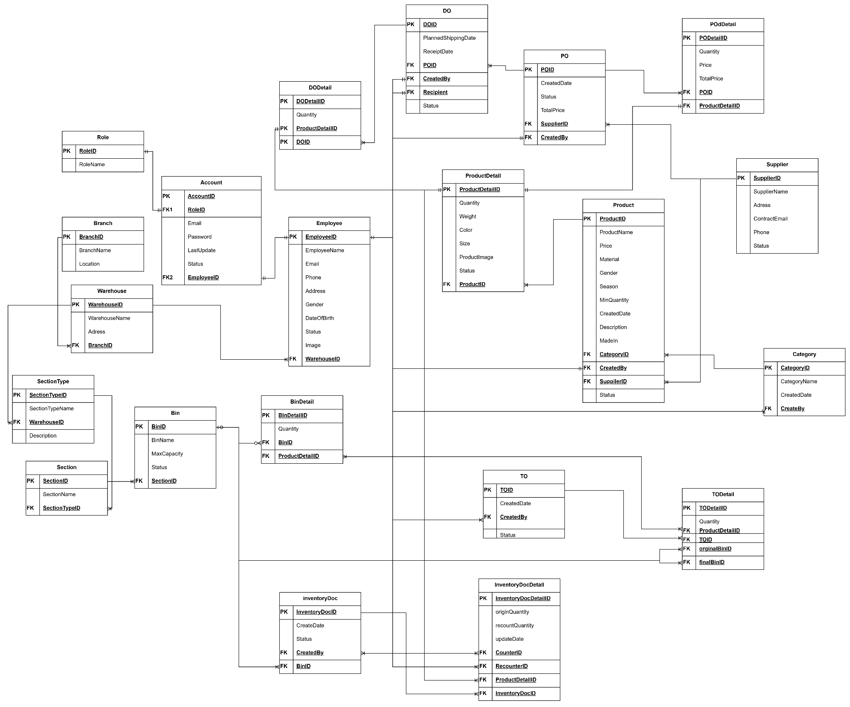
System Design Database Design

Slide 20
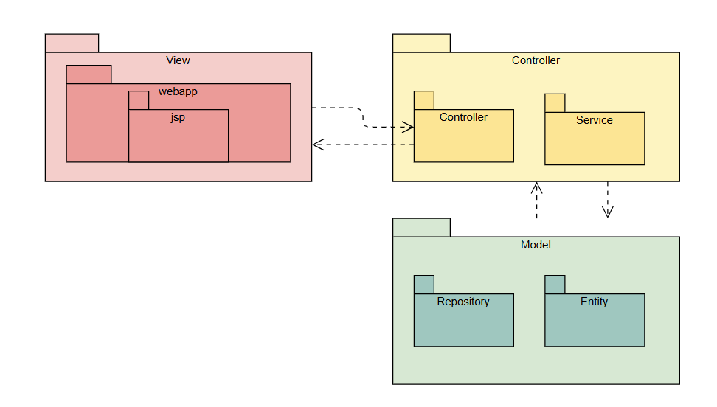
System Design Package Diagram
System package diagram:

Slide 21
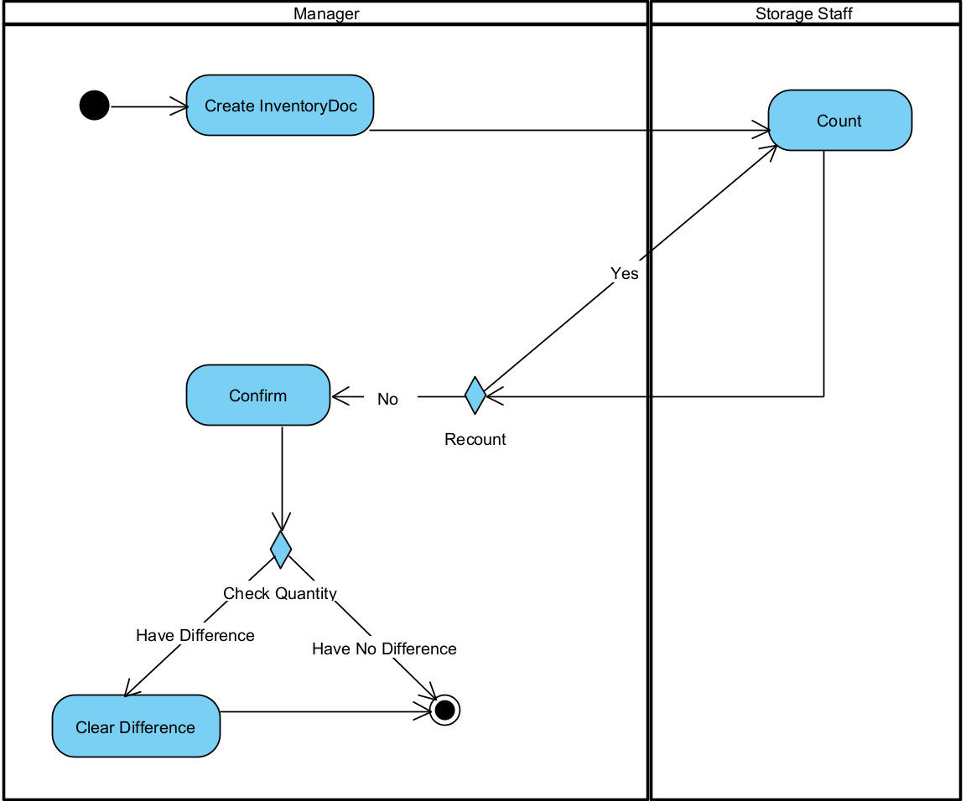
Demonstration
WorkFlow Stock Checking

Slide 22
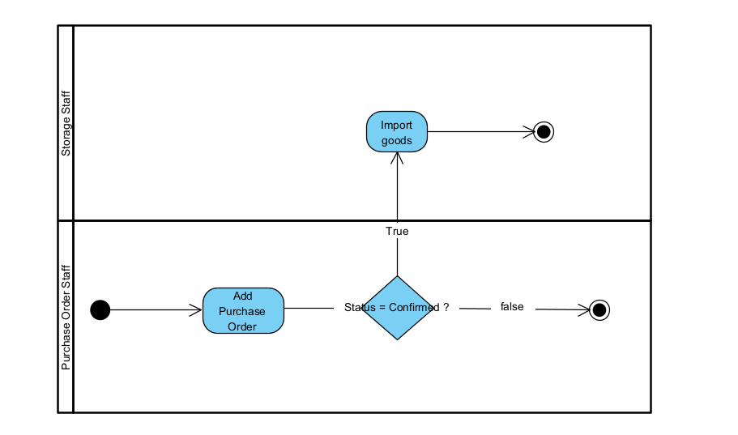
Demonstration
WorkFlow Import Goods

Slide 23
Demonstration
WorkFlow Arrange Goods

Slide 24
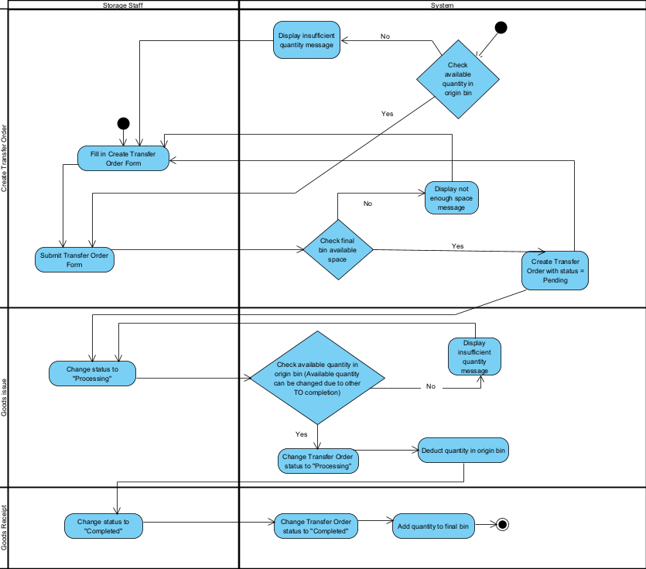

Slide 25


